Slide 1

CrowdStrike Hackathon - Every Second Counts

Slide 2
Team Name: Hash21
Theme Name: Passenger Prediction
Team Members: Ishan Singhal Sahil Agarwal Gaurang Mittal Akash Chaturvedi

Slide 3
Background: Identify the problem
The problem is to find the passengers going to India during the first quarter of every year.

Slide 4
Definition: Which problem are you trying to solve and why?
We are trying to predict the number of passengers going to india from a particular country to keep track of the total passengers travelling to and fro.

Slide 5
Solution: How your idea is solving the problem and making a positive impact on customer experience
The model we used to solve this problem is Linear Regression where we considered two parameters, one predictor variable which are intercept, bias and quarters of the year respectively. So for every country we are using this model to predict the passengers going to india.

Slide 6
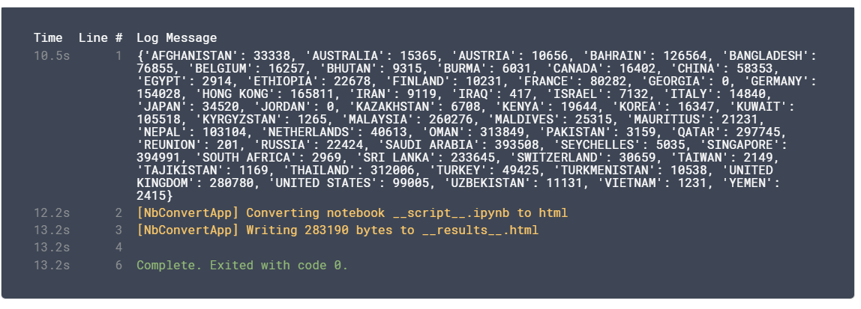
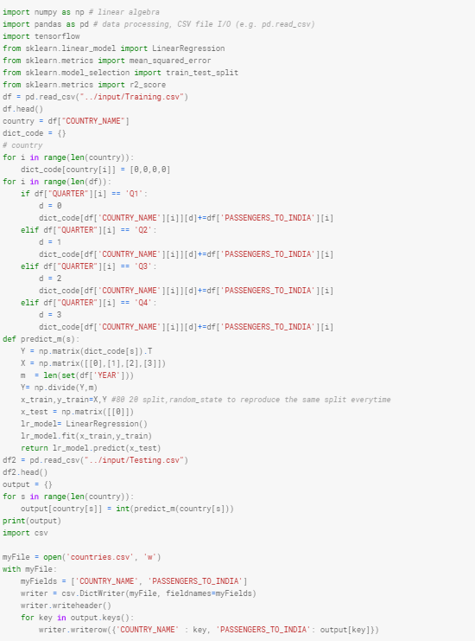
Deliver: Share images of your solution or prototype or provide a demo video link

